Slide 1

Datadog Monitoring
Introduction:
Datadog is the essential monitoring and security platform for cloud applications. We bring together end-to-end traces, metrics, and logs to make your applications, infrastructure, and third-party services entirely observable. These capabilities help businesses secure their systems, avoid downtime, and ensure customers are getting the best user experience.

Slide 2
Types of Datadog Alerts
Synthetic Alerts
Forecast Alerts
Memory Alerts
Disk Alerts

Slide 3

Synthetic Alerts Monitoring
Synthetic tests allow you to observe how your systems and applications are performing using simulated requests and actions from around the globe. Datadog tracks the performance of your webpages and APIs from the backend to the frontend. Synthetic tests can be triggered manually, on a schedule, or directly from your CI/CD pipelines.

Slide 4
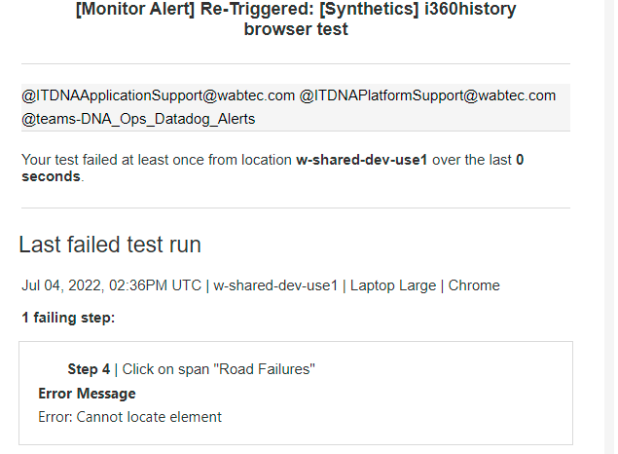
[EXTERNAL]: [Monitor Alert] Re-Triggered: [Synthetics] i360history browser test

Slide 5
If we get any synthetic alert for application
If we get any synthetic alert for application, first we need to check below details
1.URL is working fine or not
2.Data is available in all tabs.
Once Url & data fine in application then alert will automatically recover .

Slide 6
Memory Alerts Monitoring
These are the alerts will triggers once memory is reaches its threshold limit. Then we have to connect particular server and check which application is taking more memory and based on priority/requirement will take action.

Slide 7
Disk Alerts Monitoring
If any configured mounts are reaching its threshold limit then disk alerts will triggers in respected mounts.

Slide 8
Forecast Alerts Monitoring
A forecast alert predicts the future behavior of a metric
In forecast monitoring, we have memory, CPU and DISK alerts.
Note : After sometime alerts will automatically recover as they are showing future prediction.

Slide 9
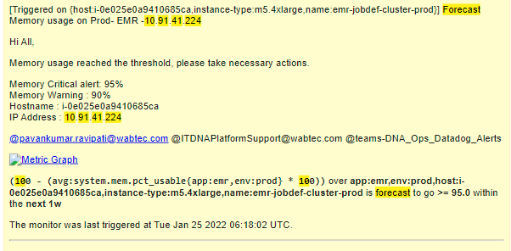
[EXTERNAL]: [Monitor Alert] Triggered: Forecast Memory usage on Prod- EMR -10.91.41.XXX on host:i-0e025e0a9410685ca,instance-type:m5.4xlarge,name:emr-jobdef-cluster-prod

Slide 10
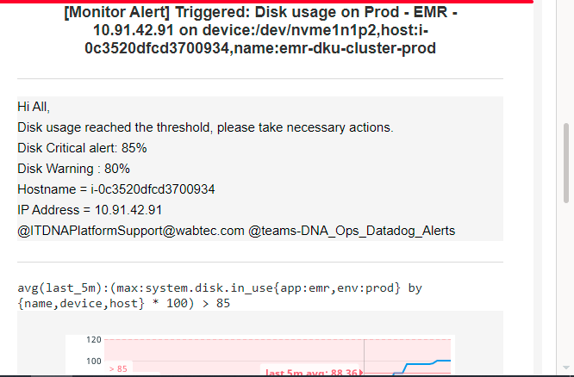
[EXTERNAL]: [Monitor Alert] Triggered: Disk usage on Prod - EMR - 10.91.42.XX on device:/dev/nvme1n1p2,host:i-0c3520dfcd3700934,name:emr-dku-cluster-prod

